Slide 1
JavaScript part 2
Barb Ericson
Georgia Institute of Technology
May 2006

Slide 2
Learning Goals
Computing Concepts
  How to do loops in JavaScript
  JavaScript operators
  How to use dialogs in JavaScript
  How to handle events in JavaScript

Slide 3
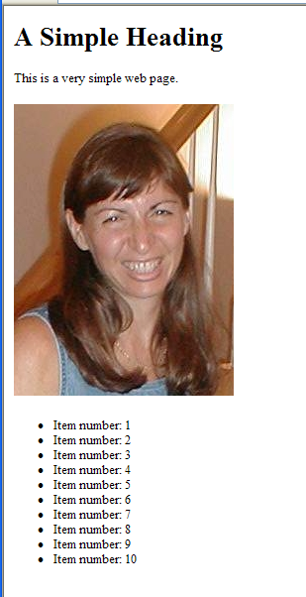
Using Loops
<html>
<head>
<title>The Simplest Possible Web Page</title>
<script>
function countToTen() {
document.write("<ul>");
for (i=1; i<= 10; i++) {
document.write("<li>Item number: ",i);
}
document.write("</ul>");
}
</script>
</head>
<body>
<h1>A Simple Heading</h1>
<p>This is a very simple web page.</p>
<p><image src="mediasources/barbara.jpg" />
</p>
<script> countToTen() </script>
</body>
</html>

Slide 4
Explaining that Function
function countToTen()
{
document.write("<ul>");
for (i=1; i<= 10; i++)
{
document.write("<li>Item number: ",i);
}
document.write("</ul>");
}
We can write out <ul> and </ul>
Creating an item for each value of i

Slide 5
Explaining that Loop
for (i=1; i<= 10; i++)
{
document.write("<li>Item number: ",i);
}
A for loop has three parts, separated by semi-colons.
  What to do first.
    set i to 1
  When to do the body
    i<=10
  What to do each time through the loop
    i++ means to increment the value of i by 1.
It’s a notation that was invented by the programming language C and has been adopted by many languages

Slide 6
Operators in JavaScript
The same kind of operators you know in Java
    + - * /
      + even works for strings, as well as numbers
    < <= > >=
    == and !=
    ! for not
Logical operators are a little weird
    && is AND
    || is OR

Slide 7
Using Dialogs in JavaScript
function check()
{
var agree = false;
agree = confirm('Do you enjoy CS?');
if (agree)
notes=prompt("Give me one good thing about CS:");
if (!agree)
notes=prompt("Why don't you like CS?");
alert("You said:"+notes);
}
…
<script> check() </script>
</body>
</html>
agree will be true or false.
!agree is not agree.
Notice: We can indent or not indent as we want here. Indentation is not important in JavaScript (or most other languages, except to the reader)

Slide 8
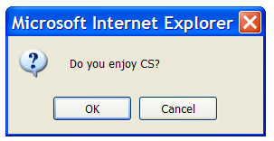
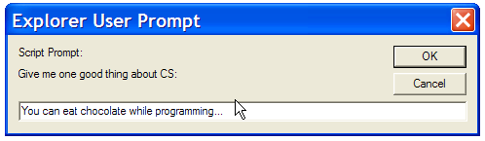
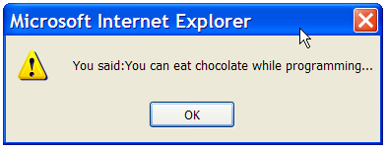
What Happens When this Runs

Slide 9
Different kinds of dialogs
Confirm: Puts up a prompt, returns true or false.
Alert: Beeps and displays one thing with an OK button. No return.
Prompt: Asks the user for a line of text. Returns that text.

Slide 10
Running on Loading the Page
This program runs when the page loads.
Is that what you really want to happen?
  The user sees nothing at all until they go to your page and then these dialog boxes happen.
Isn’t it more natural for dialog boxes to pop up when you click on something?

Slide 11
Events: Key to responding to users
The key to responding to users are events.
Events are actions taken by the user that can be caught by your program in JavaScript.
Events are caused by the user typing a key, moving the mouse, clicking the mouse, and so on.

Slide 12
Events in JavaScript
onKeyPress
onKeyUp
onKeyDown
onClick
onDblClick
onMouseOver
onMouseOut
onMouseMove
onMouseDown
onMouseUp
onChange (for text fields)
onLoad
And many, many more
  Some of them depend on the type of browser.

Slide 13
Catching an event
On appropriate tags, assign the event to some JavaScript code in a string.
  Most of these can be used with anchor or image tags.
  onLoad can be used with the <body> tag.
  onChange can be used with text fields.
    We haven’t seen them yet.

Slide 14
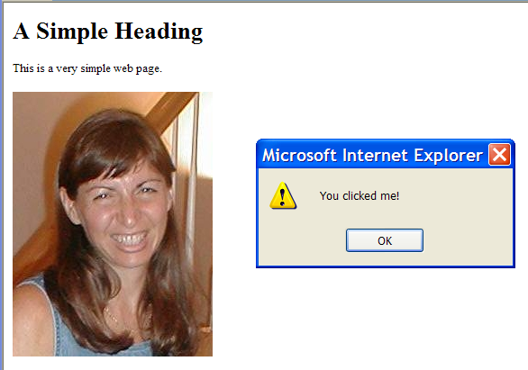
Example Event Code
<body>
<h1>A Simple Heading</h1>
<p>This is a very simple web page.</p>
<p><image src="mediasources/barbara.jpg" onClick='alert("You clicked me!")' />
</p>
</body>

Slide 15
Exercise
Create a Web page that has a picture in it and when you click on the picture
  change some text on the page
Create a Web page that has a picture on it and when you click on the picture
  Use a dialog to show the number of times it was clicked on

Slide 16
Summary
JavaScript loops are like Java's loops
  For and while loops
JavaScript operators are like Java's operators
  Except for AND and OR
There are three types of dialogs in JavaScript
  Confirm, alert and prompt
You can respond to user events
  Like onClick, onChange, onMouseMove

